Slide 1
Manager development process and training
Session 17

Slide 2
Manager Development: The use of long-term, future oriented programs to develop a person’s ability in managing.
Manager Training: The use of mostly short-term programs that facilitate the learning process to help managers do their jobs better.

Slide 3
Approaches to Manager development: On-the-job training
Planned progression
Job rotation
Creation of “Assistant-to” positions
Temporary promotions
Committees and junior boards
Coaching

Slide 4
Approaches to manager development: Internal and External training
Conference Programs
University management programs
In-House “Universities”
Readings, Television, video Instruction, and online education
Business simulation and Experiential exercises
E-Training

Slide 5
Managing change
The forces for change may come from the external environment, from within the organization, or from the individuals themselves.

Slide 6
Changes that affect Manager and Organization development
The increasing use of computers
Lifelong learning becomes a necessity
The proportion of knowledge workers will increase and the need for skill workers will decrease.
The shift from manufacturing to service industries
The choice of educational opportunities will expand.
There maybe greater cooperation and interdependence between the private and the public sector.
Internationalization will continue.

Slide 7
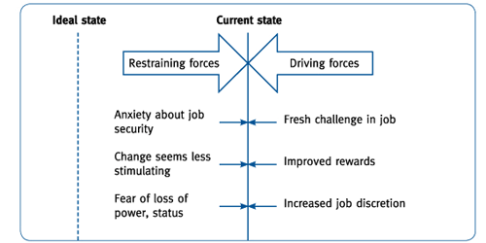
Resistance to change

Slide 8
Kurt Lewin’s model of change process
Unfreezing
Changing
Refreeze

Slide 9
Organizational Conflict
Conflict is a part of organizational life and may occur within the individual between individuals, between the individual and the group, and between groups.

Slide 10
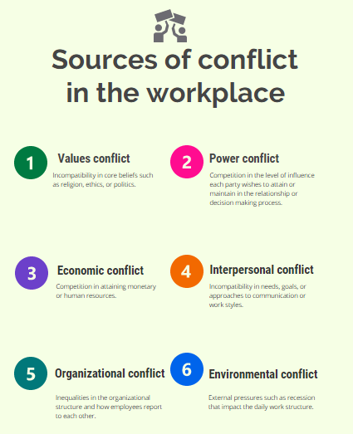

Slide 11
Managing conflict
Conflict can be managed in different ways, some focusing on interpersonal relationships and others on structural change

Slide 12
Organization development
OD is a systematic, integrated, and planned approach to improving enterprise effectiveness. It is designed to solve problems that decrease operating efficiency at all levels. Such problems may include lack of cooperation, excessive decentralization, and poor communication.

Slide 13
Techniques of OD
Laboratory training
Team building
Job design
Stress management
Career and life planning
MBO

Slide 14
OD Process
Development of change strategy
Problem recognition
Organization diagnosis
Feedback
Interventions
Measurement and evaluation

Slide 15
Learning organization
An organization that can adapt to changes in external environment through continuous renewal of its structure and practices.

